Slide 1
Let’s celebrate – then get to work!
Public and membership Meeting
November 6, 2014

Slide 2
Overview of tonight’s meeting
Why we’re here
What you told us
What we’ve accomplished
Projects we’re working on
Where we are now
What’s next
How you can help

Slide 3
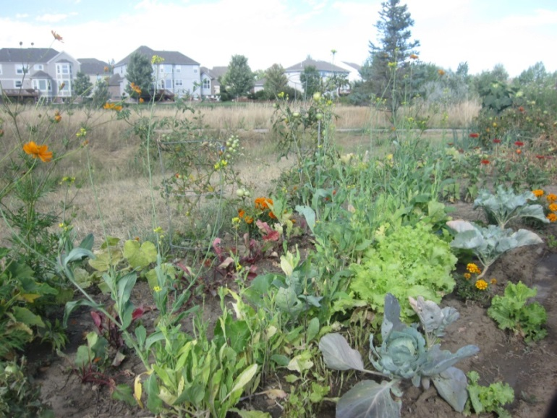
Why we’re here
Vision
To create a healthy community through a resilient, local food system
Mission
To support and promote local food production, manufacturing, distribution, and consumption

Slide 4
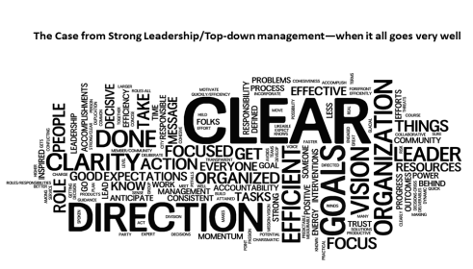
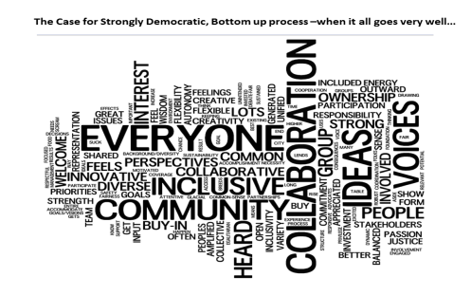
What you told us

Slide 5
What you told us
Need a strong leader who will get it done
Board to serve as feedback loop and accountability
[Advisory committee] of a diverse group with backgrounds in economic, farming, production, retail
Bottom-up involvement; need to have something at stake
Transparency is a must
Include those missing, including voices of low-income
Multi-modal forms of communication
Clear goals so everyone is working in the same direction
Deadlines so decisions get made, don’t wait for everyone to agree

Slide 6
You've helped us get here
Created formal structure for 501(c)(3) status
Raised $40,000 in funding, hired 2 contractors
Built membership/partnership model
Transitioned Winter Markets
Established logo, email, website, and contact list with monthly newsletters
Held 5 Public Meetings
Formed Task Forces/Sub-Committees

Slide 7
You’ve helped us get here
Listed in the Colorado Food Coalition Directory
Represented on the Colorado Food Coalitions Steering Committee
Supported urban ag policy changes in Ft Collins
Supporting a Community Marketplace
Legislative Advocacy at the statewide level
Assisted the City’s Climate Change Task Force

Slide 8
Projects we’re working on
Fort Collins Winter Markets
High Impact Project Prioritization
Influencing Local, State, and National Policy
Cluster
Strategic Plan
Structure
Outreach
Funding

Slide 9
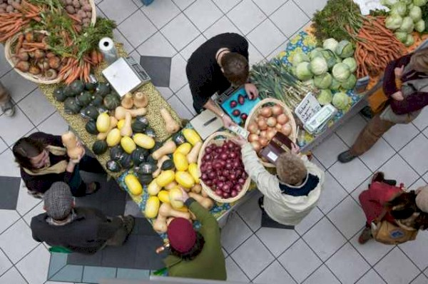
Fort Collins Winter Markets
Opera Galleria in Fort Collins
Starting this Saturday Nov 8th– volunteers needed!
NoCo Food Cluster Membership Table
Over 50 local farmers, producers and craft vendors
Life music
Kids zone

Slide 10
High Impact Project Prioritization Tool
 | Economic Impact |  |  | Broader Public Benefits |  |  | Feasibility |  |  | Total
Selection Criteria | Small Farms and Food Biz | Invest in Food System Infra-structure | Public Spaces in Food Production | Health Food Access | Environmental Implications | Conserve Farm and Ranch Lands | Potential Effectiveness | Resources - Financial | Resources - People | Weight
Weighting Scale | 5% | 20% | 10% | 20% | 10% | 15% | 10% | 5% | 5% | 100%
Intuitive assessment tool automatically rolls up weighted results
Tool includes built-in, step-by-step walk-through of the process

Slide 11
Prioritized High Impact Projects
Projects & Initiatives | Project Score | Economic Impact | Broader Public Benefits | Feasibility
Support for Food Access-Growing Project, FoCo Cafe | 6.2 | 1.9 | 2.8 | 1.5
Ag Enterprise Zones | 6.1 | 2.2 | 2.3 | 1.6
Winter Markets | 6.0 | 1.5 | 2.6 | 1.9
Community Action Alerts | 5.9 | 2.1 | 2.1 | 1.7
Land leases to beginning/specialty crop farmers | 5.9 | 1.9 | 3.0 | 1.0
Farm Incubator with City | 5.6 | 1.8 | 2.6 | 1.2
Community Market | 5.3 | 2.4 | 2.0 | 0.9
Urban zoning for food production | 5.3 | 1.8 | 2.2 | 1.3
Processing kitchen | 4.8 | 2.4 | 1.4 | 1.1
Tax deductions for Food Donations | 4.4 | 0.5 | 2.5 | 1.4

Slide 12
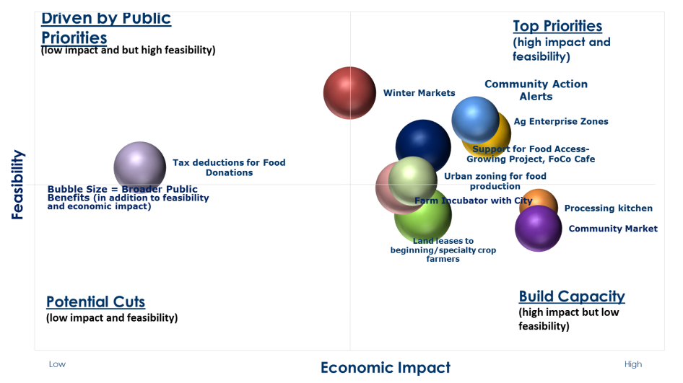

Slide 13
Local Policy: Where have we been?
Ft Collins Urban Ag Phase I: 2012-2013
Allowed Urban Ag in all zone districts, allowed farmers markets in more districts, and animals in more districts (chickens/ducks scaled per lot, updated bee regulations, added goat licenses)
Ft Collins Urban Ag Phase II: 2013-2014
City Council adopted regulations exempting Hoop Houses from building permit requirements

Slide 14
State Policy: Where have we been?
State Level Bills Legislative Session 2014
Tax Credit for Donating Food
HB 14-1119: 25% Tax Credit
Eligibility Age School Protection Program
HB 14-1156: Access to healthy lunch
Greenhouse and Nurseries
SB14-043: Reclassification of structures used to grow food on residential lots

Slide 15
Nat’l Policy: Where have we been?
White House Task Force
April/May 2014: Solicited community feedback on local food systems for Ft Collins Mayor Weitkunat, presented to the White House Climate Preparedness and Resiliency Task Force
Let’s Move!
Worked with Ft Collins City Staff on the Let’s Move Town and Cities Initiative
Sept 2014: Fort Collins recognized as the #1 City in the nation in promoting healthy living!

Slide 16
Local Policy: Where are we going?
Strategic Outlook - 4 theme areas
Production
Ex) Farm Preservation
Enterprise Zones /Ag Incentive Bill
Distribution
Ex) Schools/Institutions: Food to Farm Pilot
Consumption
Ex) Double SNAP at Farmers Markets
Waste/Recycling
Ex) Year round composting

Slide 17
Upcoming Community Events
Fermenting Fun with the Food Co-op
Tues Nov 11, 6-8pm, Northside Center
Fort Collins Foodie Walk!
Old Town Fort Collins, Friday Nov 21, 5-9pm
PSD Turkey Round Up benefiting the Food Bank of Larimer County
Weds Nov 19, 8am-4pm
Local Farmers & Producers Focus Group
Tues Nov 25, 5-7pm, Community Room 215 N Mason
COLORADO GIVES DAY: Tues Dec 9

Slide 18
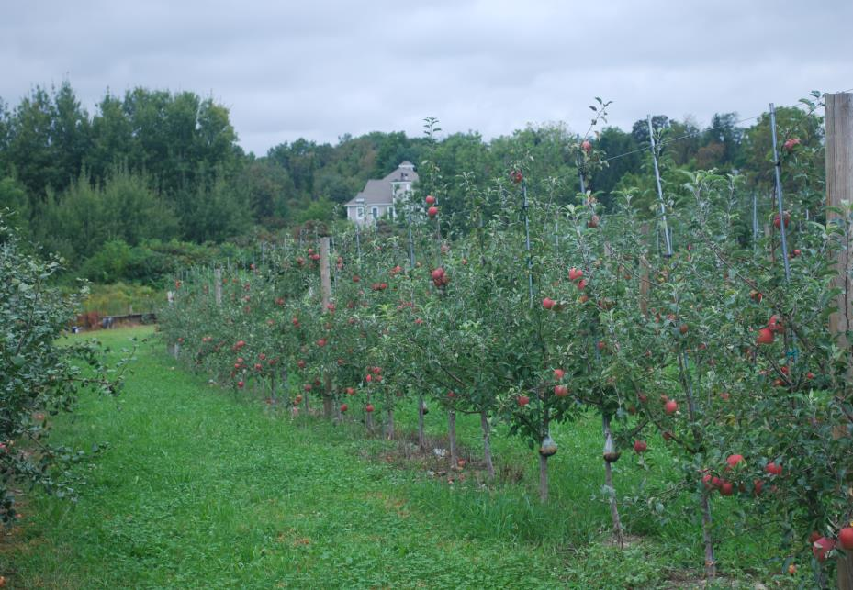
Where we are
Up to now
Volunteer organized, staff supported
To make a real impact
Staff organized, volunteer powered
Broad based member/partner/board involvement
Wikimedia

Slide 19
Organizational Structure
Community
Members
Committees
Task Forces
Partners
Advisory Committee
Sponsors
Board of Directors
Staff

Slide 20
Board and Advisory Committee
Board of Directors - $3,000
Provide leadership of high-impact food system projects
Secure and allocate resources for greater economic development and social impact
Guide the strategic direction of the NCFC
Advisory Committee - must be a Partner to serve
Contribute to the Food Cluster’s scope and projects
Influence public policy decisions
Inform the NCFC of resources and opportunities
Network with other food system leaders

Slide 21
Cluster Partners
Comprised of individuals, organizations, businesses
Collaborate formally on high impact projects
Network and socialize at events
Eligible to serve on the Advisory Committee
Promotional use of Food Cluster logo
Promotion of organization or business and events

Slide 22
Cluster Members
Stay informed with a monthly newsletter
Invitations to public meetings and events
Outlet for community development and service opportunities
$50 annually

Slide 23
What’s next
Raise $50k additional funds by end of 2014
Match $30k from City of Fort Collins
$10k from CanDo
Significant in-kind donations
Hire Executive Director beginning of 2015
Coordinator through end of year
Need dedicated effort to make impact we need
Grow Board, Advisory Committee
Help direct and fund the organization to succeed

Slide 24
How you can help
Become a founding member or partner
Cash is vital, hours also appreciated
How are you going to plug in?

Slide 25
Thank you
All the committee volunteers
Board Members
Gardens on Spring Creek – Michelle Provaznik
Food Bank for Larimer County – Susan Kelly
Spring Kite Farm – Michael Baute
Advisory Committee Members
UC Health / CanDo Coalition
City of Fort Collins Economic Health
CSU Department of Agriculture and Resource Economics
CSU Center for Public Deliberation
NoCo Food Incubator
Trebuchet Group
Coordinator Ashley Colpaart
Logo donation
Marcus Fitzgibbons - Brand Iron
Be Local Northern Colorado transition
Board member - Katie Schulze
Tally Service - Chrysta Bairre, Beth Hutchinson
Pollock LLP - Amy Cheree Brown
Structure support
Everybody Loves Sauce - Hunter Buffington

Slide 26
Thank you to our partners and everyone involved to date!

