Slide 1
A systematic review of cultural capital in U.S. community development research
James Hale, Colorado State University, james.hale@colostate.edu
Aiden Irish, Ohio State University, Irish.20@osu.edu
Michael Carolan, Colorado State University, michael.carolan@colostate.edu
Jill Clark, Ohio State University, clark.1099@osu.edu
Shoshanah Inwood, Ohio State University, inwood.2@osu.edu
Becca Jablonski, Colorado State University, beccajablonski@gmail.com
Tom Johnson, University of Missouri, JohnsonTG@missouri.edu
Notes:
I’m here today as part of a research team working on a systematic lit review of cultural capital. Through our work various research and practice experiences in community development, we have found that the way that cultural capital is understood and used is underdeveloped, varied, and even contested. So we decided to do what many researchers do – let’s do a review of the literature!

Slide 2
How is cultural capital conceptualized and deployed in U.S. focused community development research? How is it operationalized?

Slide 3
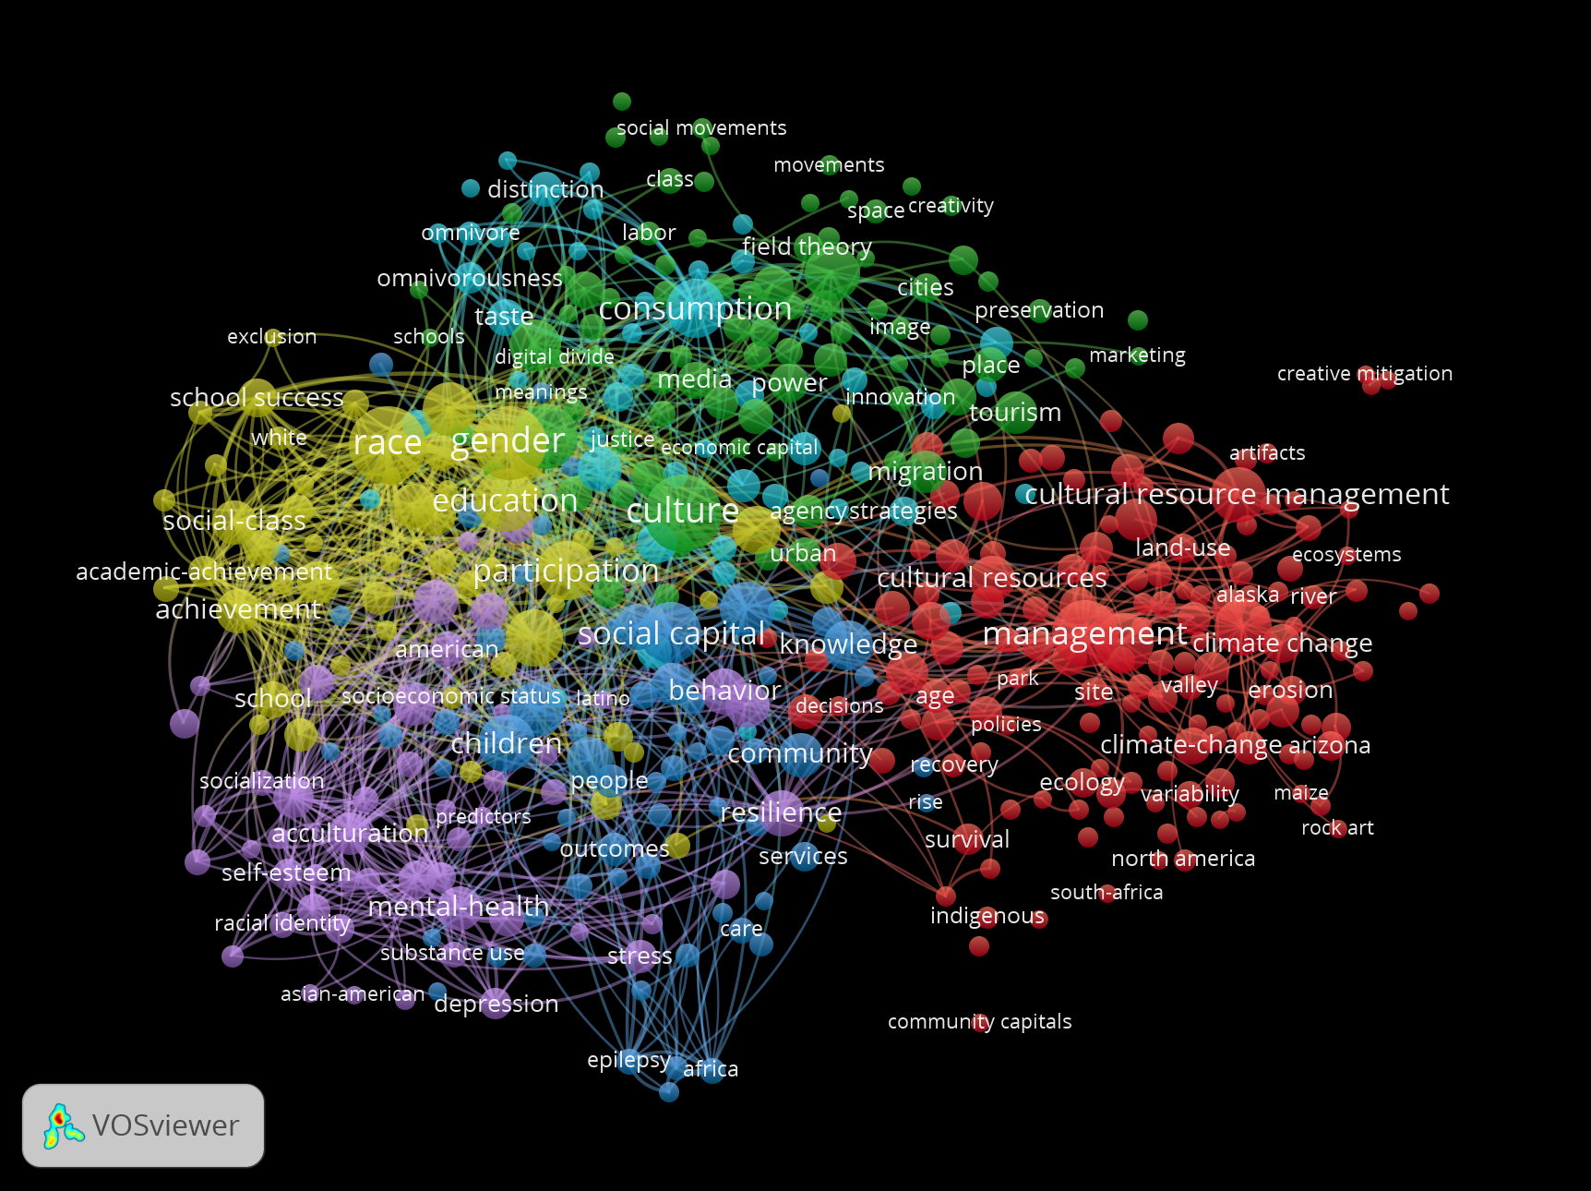
How is cultural capital conceptualized and deployed in U.S. focused community development research? How is it operationalized?

Slide 4
How is cultural capital conceptualized and deployed in U.S. focused community development research? How is it operationalized?
Inclusion:
Research population in U.S.
Peer-reviewed studies with stated conceptualization of cultural capital or related topics
Community development focus which we define as being concerned with how the quality of interaction among people and places improve over time. Central to this idea is collective agency which is the ability of a group to solve common problems together
Exclusion:
Study populations outside U.S.
Studies from before 2002
Educational studies
Healthcare studies
Archeological methods articles
Commentaries
Articles that do not reference development in some way or are at an individual level without connection to community
Focused upon an discipline or institution without also discussing development
Articles on based on interest based associations in community development without also using a place based associations of community development.

Slide 5
How is cultural capital conceptualized and deployed in U.S. focused community development research? How is it operationalized?
Records identified through database searching (Web of Science, Academic Search Premier, Google Scholar)
n = 3372
Records after duplicates removed
n = 3055
Records screened (title only)
n = 3055
Records excluded
n = 1753
Records screened (title and abstract)
n = 1302
Records excluded
n = 967
Full-text articles assessed for eligibility
n = 335
Records excluded
n = 199
Studies included
n = 136
Notes:
Co-coded and met weekly to discuss process and examine discrepancies.

Slide 6
Some initial impressions
Discipline
Varied – anthropology, sociology, geography, planning, economics, tourism, natural resource management
Methodology
Tending to be qualitative, case studies. Also mixed methods and some quantitative.

Slide 7
Some initial impressions
Cultural capital conceptualization themes
Group distinction
Connection to place
Objectified
Embodied
Knowledge, attitudes, norms, beliefs, values
Media and arts
Notes:
Group distinction based upon class, racial or ethnic identity and histories, consumption and production

Slide 8
Some initial impressions
Cultural capital application themes
Preservation
Conservation
Participation
Equity
Generative/limiting of community development
Creative industry
Economic development

Slide 9
Next steps
Continue analysis of themes, possibly with a correspondence analysis
Analyze within subcategories
Catalog secondary data datasets
Write up results for dissemination

